Slide 1


+++ Live +++ +++ Live +++ +++ Live +++
Welcome
to
Software Engineering
Lesson WS2020/2021
Starting at 14:15
survey

Slide 2

+++ Live +++ +++ Live +++ +++ Live +++
The rule No1
Keep your camera on

Slide 3

+++ Live +++ +++ Live +++ +++ Live +++
Software Engineering
WS-2020-2021
Lesson Mo. 14.15-17.45 h Lab: Thur. 14.00-16.00 h
Room 8-103
https://www.linkedin.com/groups/8689804/

Slide 4


Hierarchical Temporal Memory
Damir Dobric
Microsoft PTSP (Partner Technical Solution Specialist) Microsoft Most Valuable Professional
Blog
Twitter
damir.dobric@daenet.com b-dadobr@microsoft.com

Slide 5
AI / ML
Where we are

Slide 6
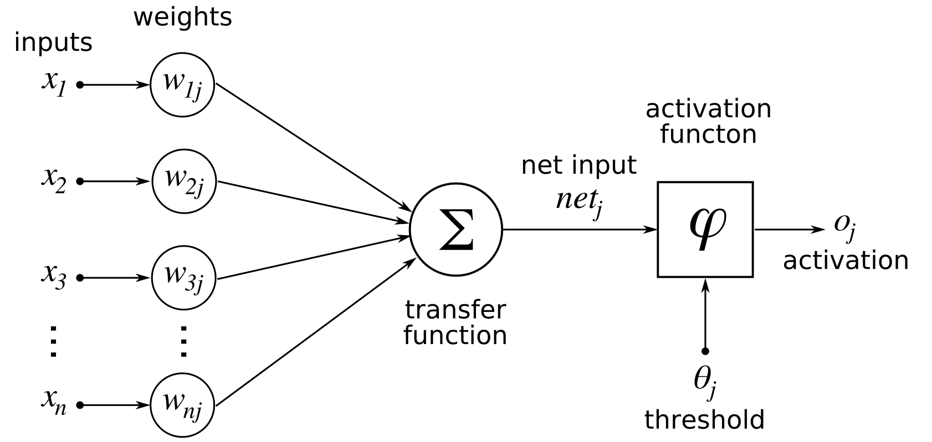
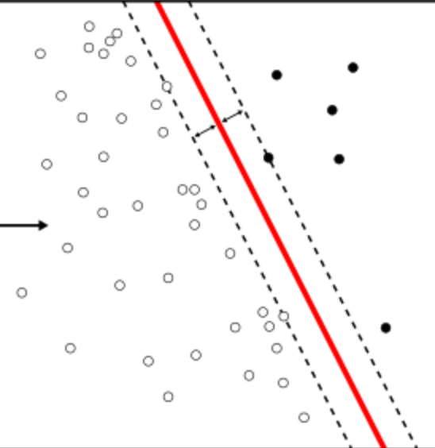
Perceptron
e = xW.

Slide 7
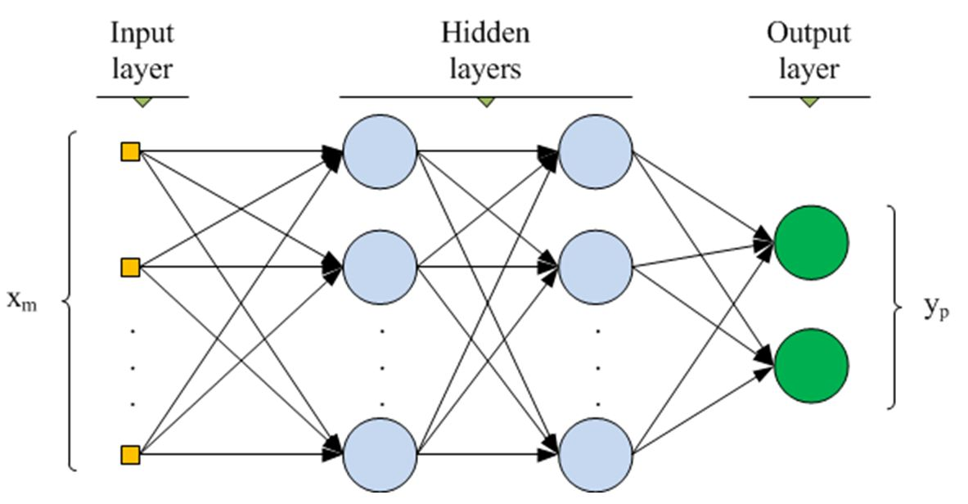
Multilayer ANN
www.cs.us.es/~fsancho/?e=135

Slide 8
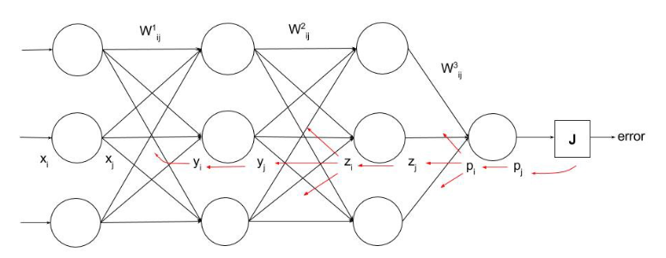
Backpropagation
https://ayearofai.com/rohan-lenny-1-neural-networks-the-backpropagation-algorithm-explained-abf4609d4f9d

Slide 9
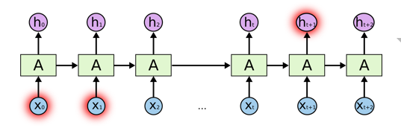
RNN
colah.github.io/posts/2015-08-Understanding-LSTMs

Slide 10
NEOCORTEX
Learning from brain

Slide 11

Brain
Neocortex
(rational)
Limbic
(emotional)
Reptilian
(instinctual)
http://siimland.com/what-to-feed-your-neocortex-to-boost-brain-power/
https://www.shutterstock.com/video/clip-540940-stock-footage--d-render-xray-style-image-of-the-human-brain-hd.html

Slide 12

Neuron

Slide 13
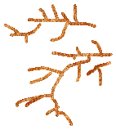
Neuron

Slide 14
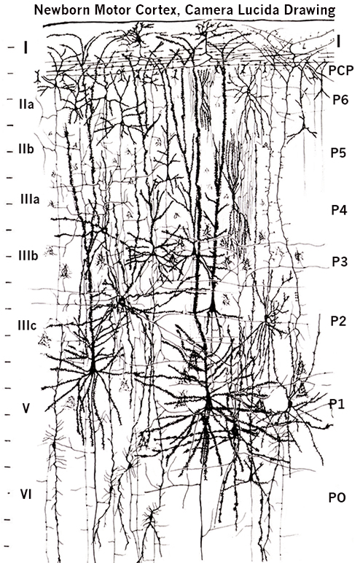
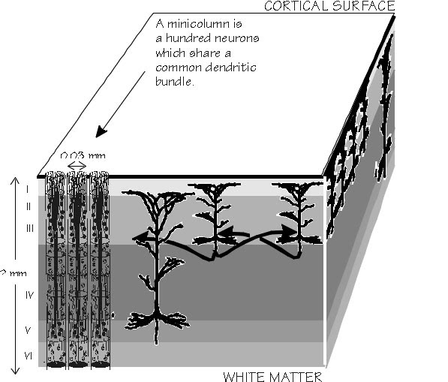
Layers and columns in neocortex
by Santiago Ramón y Cajal (1852-1934)
https://academic.oup.com/brain/article/125/5/935/328135

Slide 15
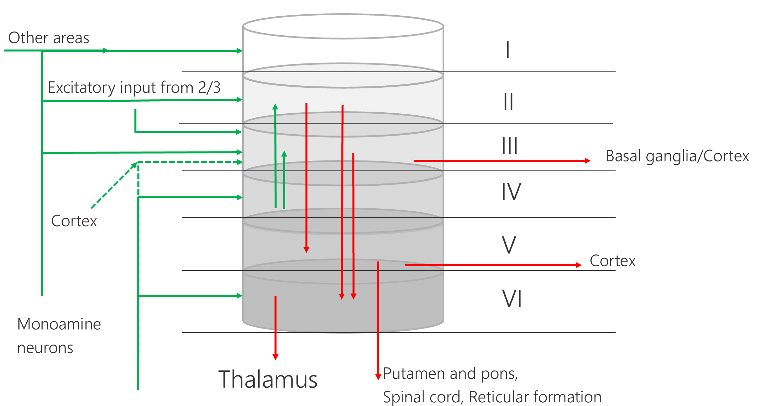
Model of a cortical column

Slide 16
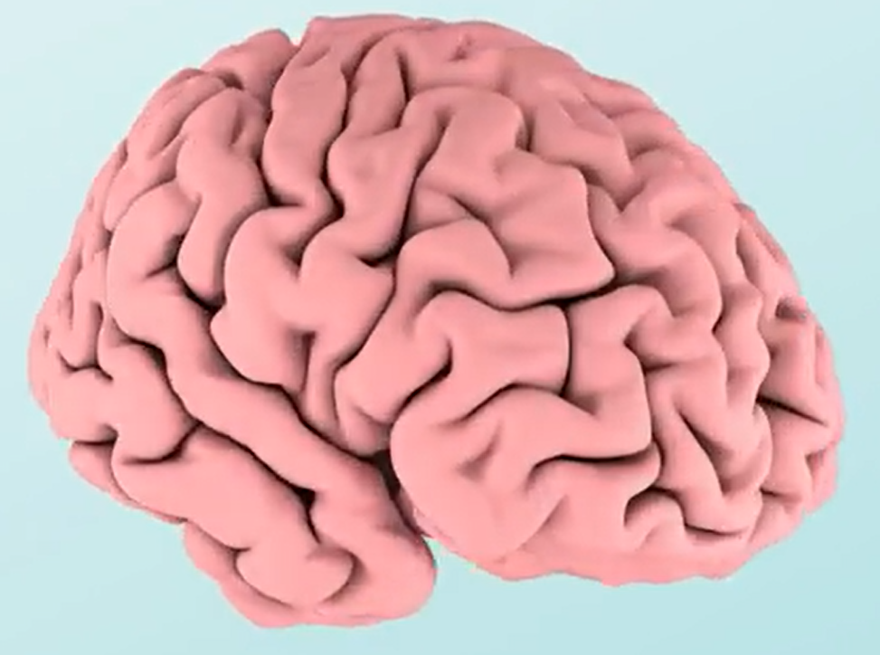

Layers and columns in neocortex

Slide 17
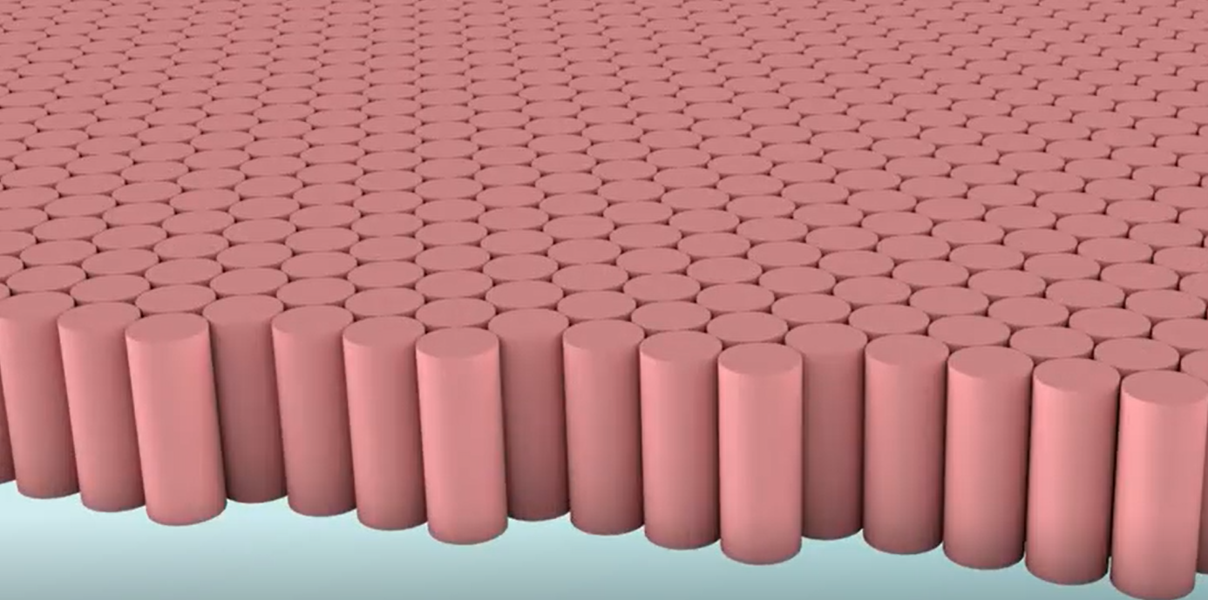
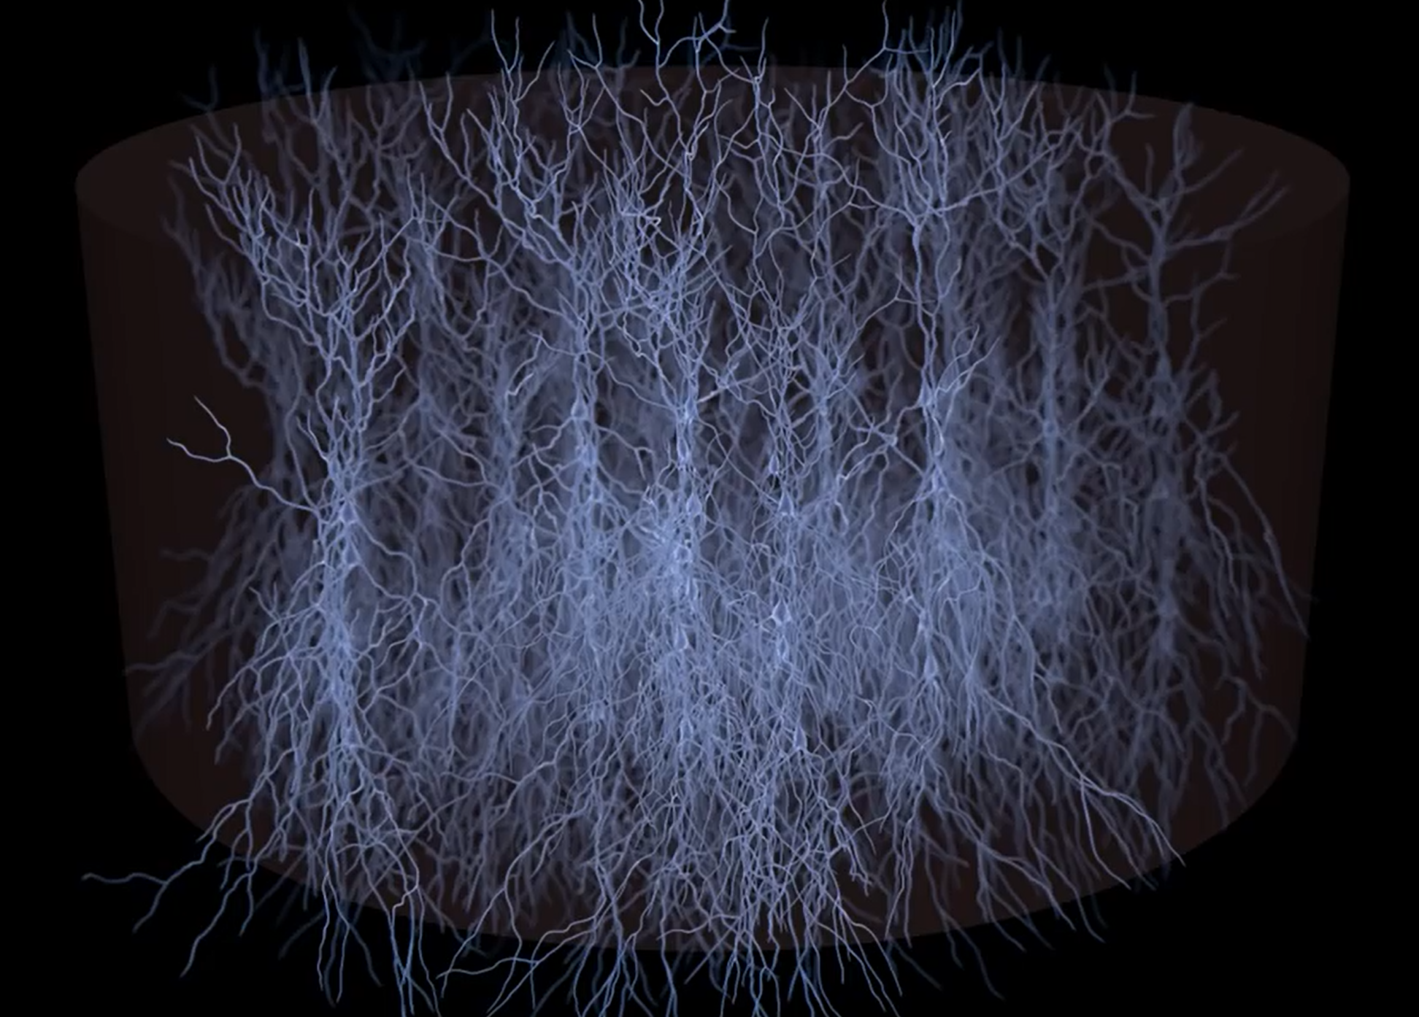
Cortical column with mini-columns
Video

Slide 18
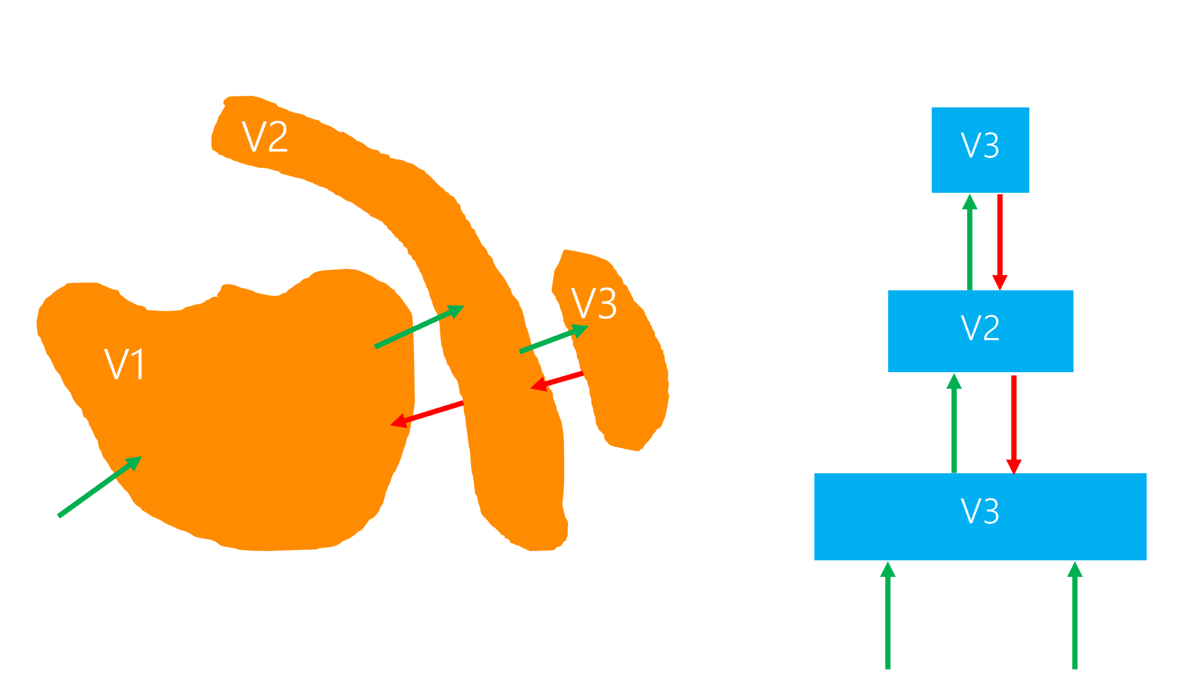
Hierarchical Semantic Layers

Slide 19
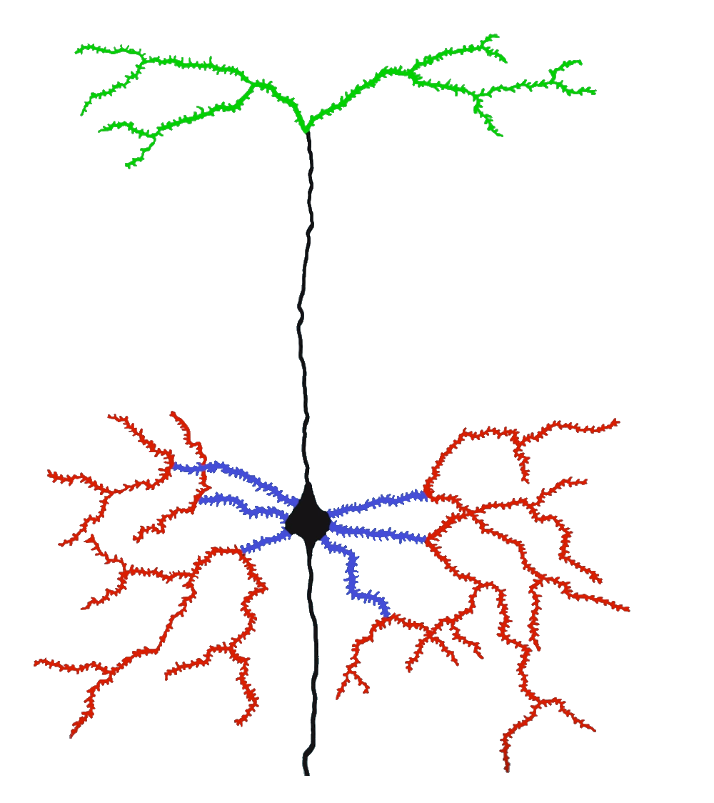
Hierarchical Temporal Memory Cortical Algorithm
Inspired by Neocortex
Different model of artifficial neuron
Dynamic Synapse grow
Inhibition
Boosting (homeostatic elasticity)
Two algorithms
Spatial Pooler
Temporal Memory
Feedback (apical)
Context (distal)
Feedforward (proximal)

Slide 20
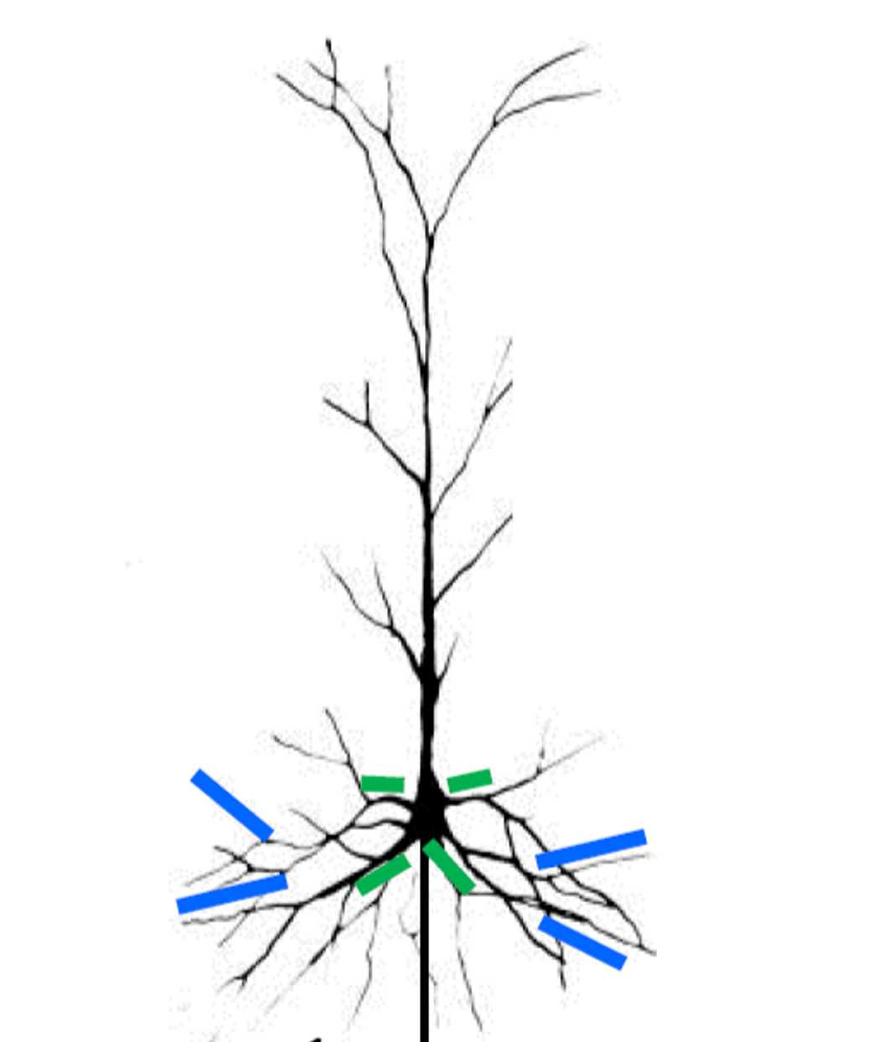
Neural Cell Model
Postsynaptic cell
Owner of the segment
Distal Dendrite Segment
Presynaptic cell
Receptor Synapses

Slide 21
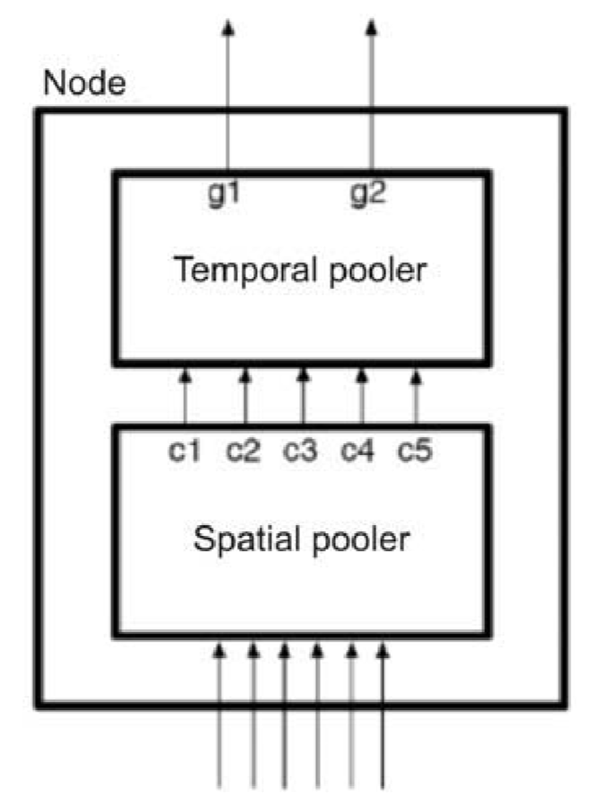
HTM CLA two algorithms
Spatial Pooler
Temporal Memory (Temporal Pooler is the old name)
Encoder

Slide 22
The column with SP and TM
Mini-columns
column
Temporal Memory
Spatial Pooler
Sensory input
0
0
0
1
1
1
0
1

Slide 23
ENCODER

Slide 24
What is an encoder?
HTM systems require data input in the form of Sparse Distributed Representations (SDRs)
SDR = Sparse Date Representation
An SDR is a large array of bits of which most are zeros and a few are ones.
First step of using an HTM system is to convert a data source into an SDR
https://pdfs.semanticscholar.org/1455/2052a0ee729539298e4f8eb42292c0eb1622.pdf

Slide 25
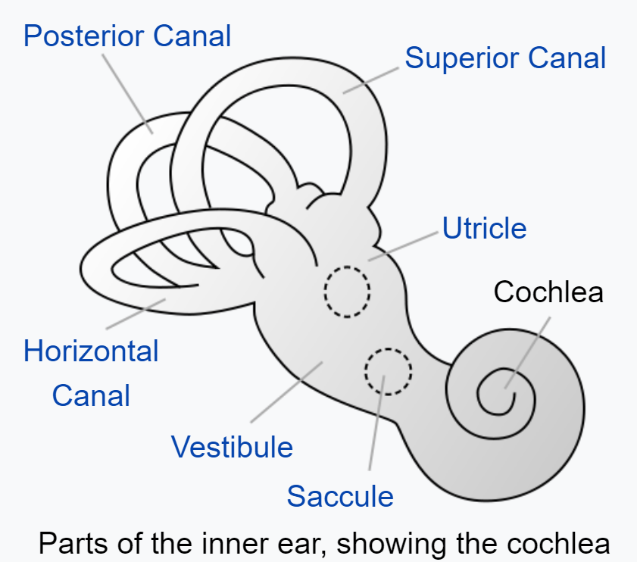
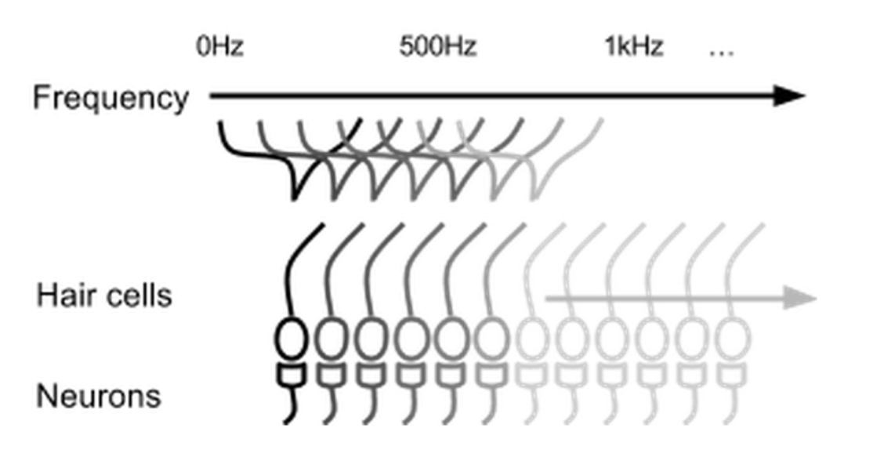

Parts of inner ear - Cochlea
Cochlear hair cells stimulate a set of neurons based on the frequency of the sound.

Slide 26
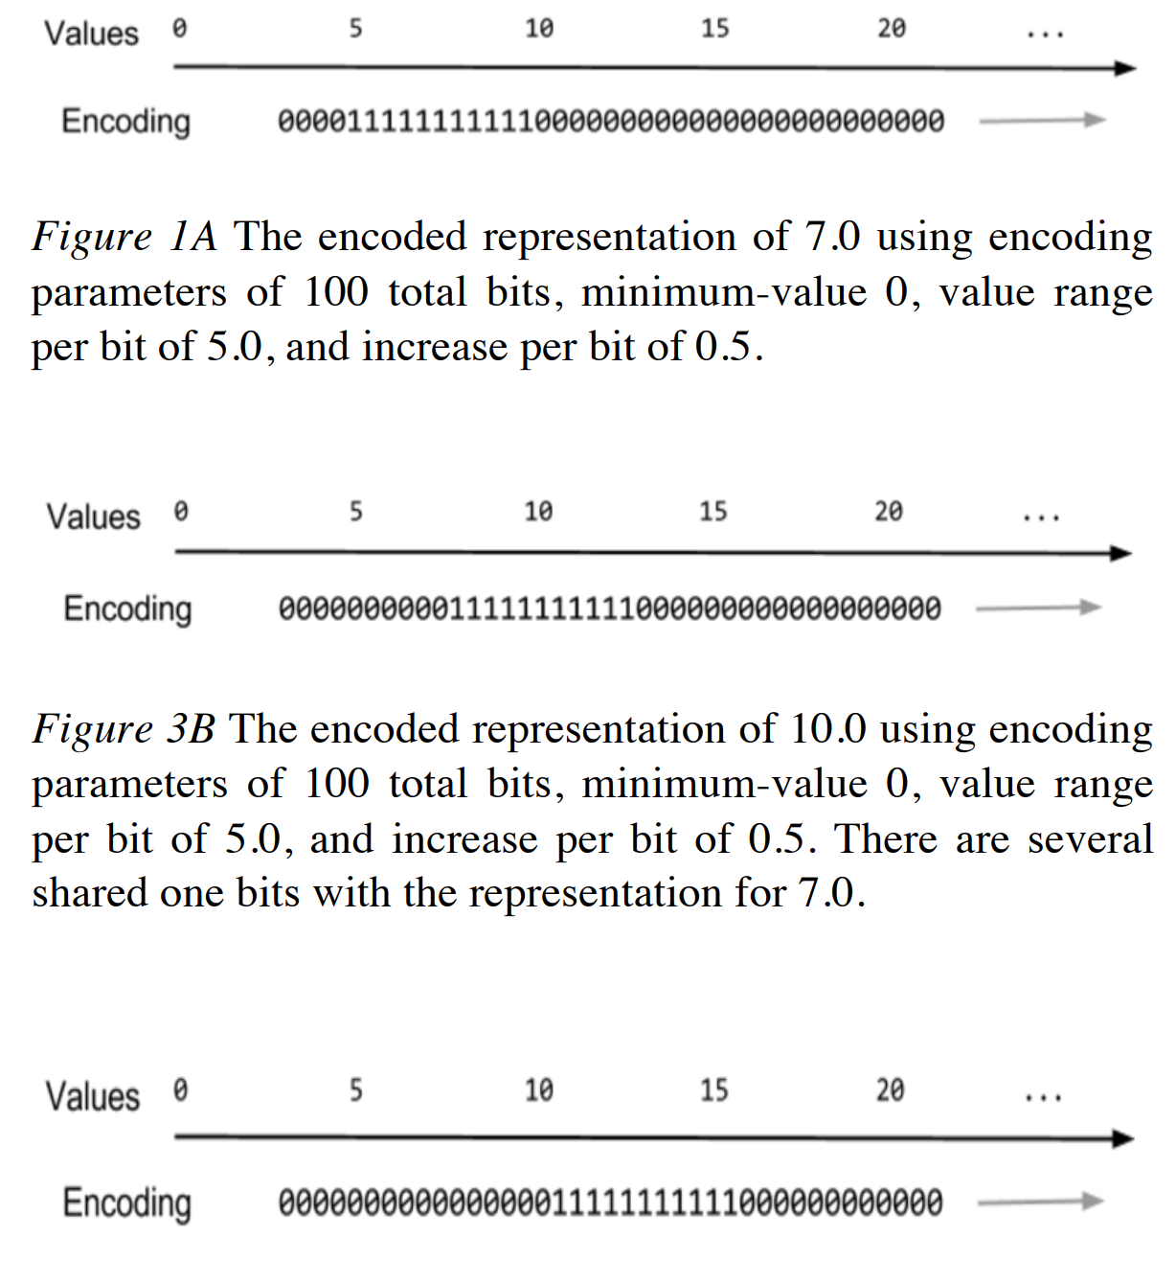
Encoding of scalar values

Slide 27
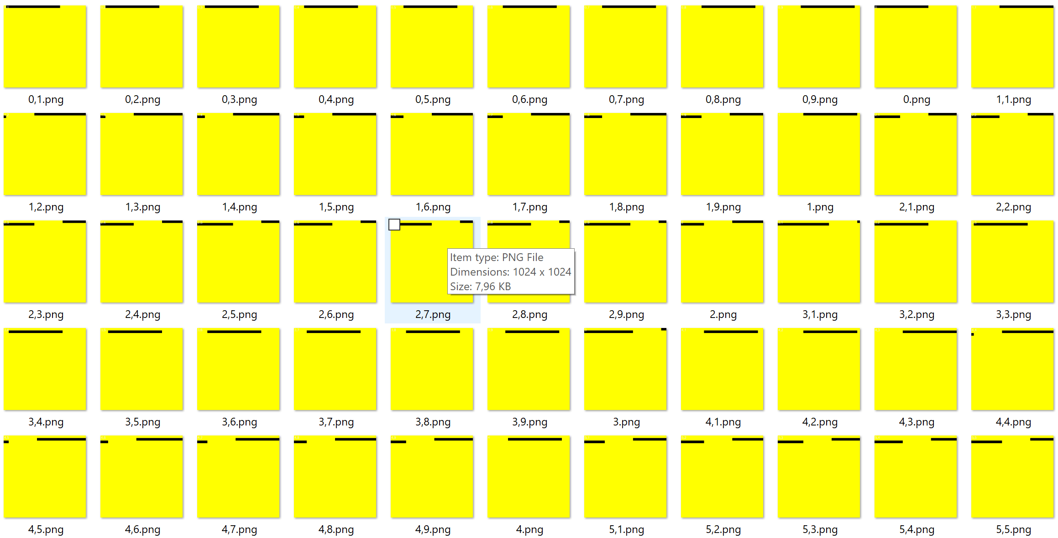
Example: Encoding of scalar values

Slide 28
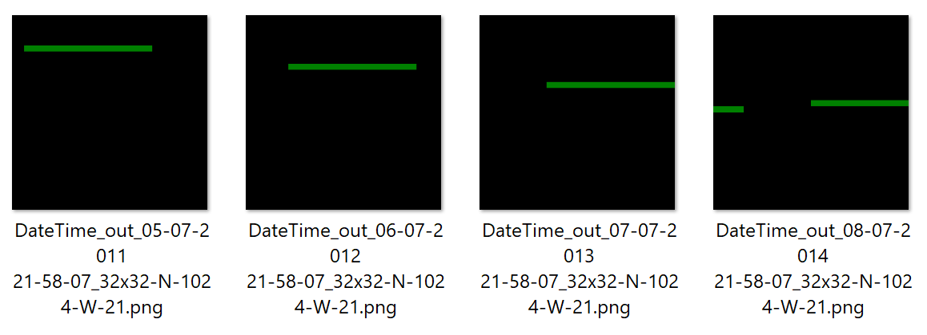
DateTime encoder

Slide 29

Definitions

Slide 30

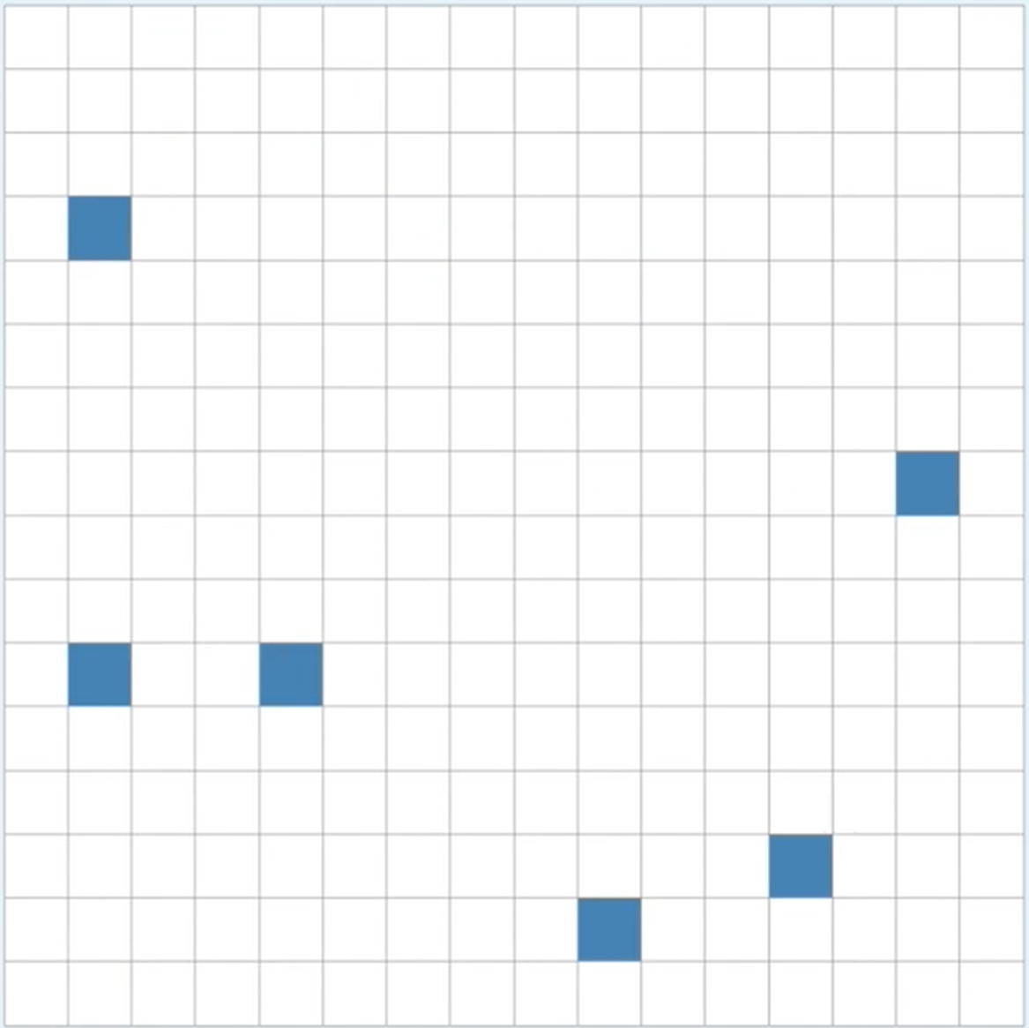
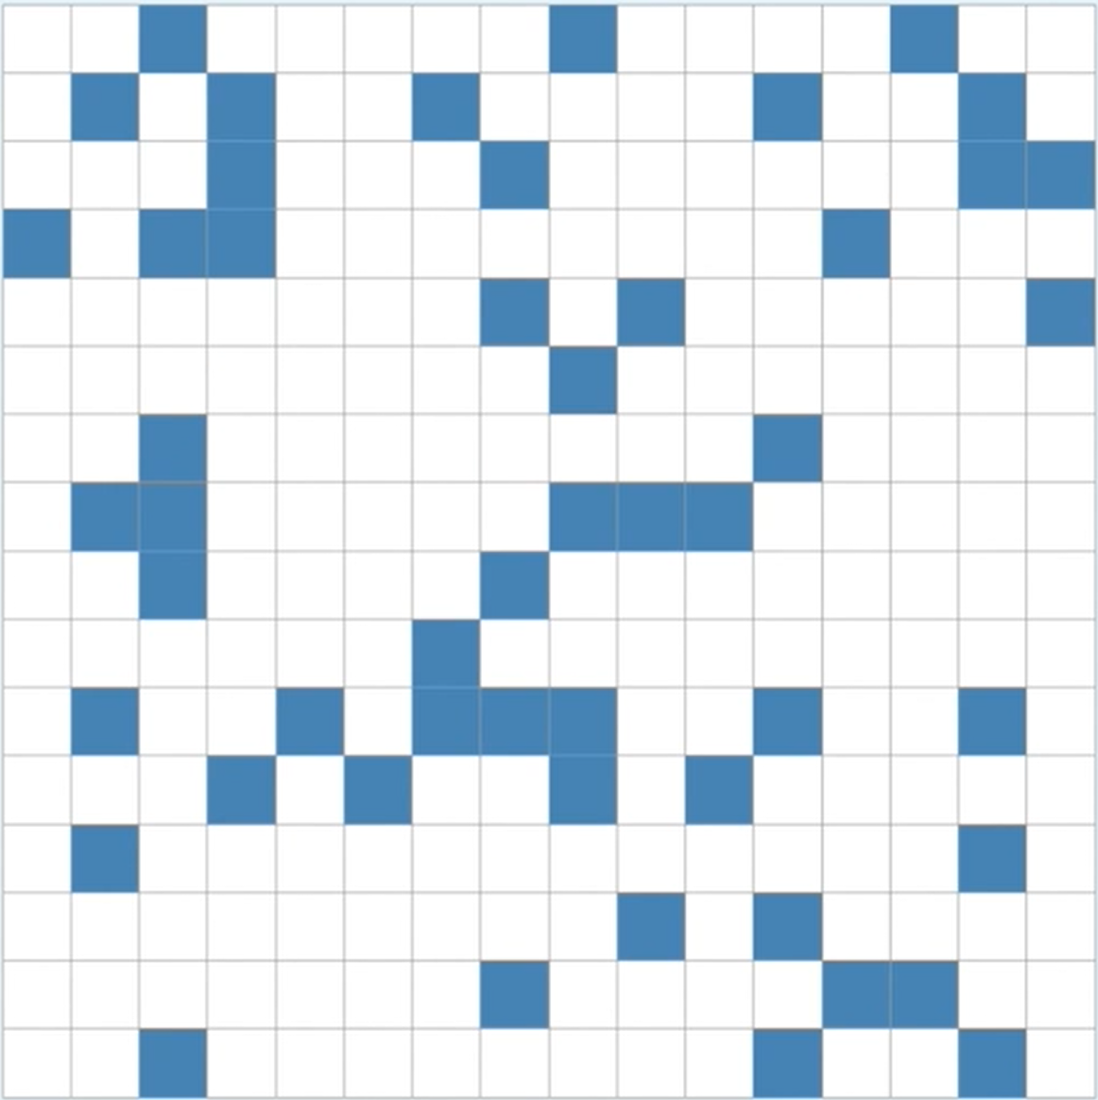
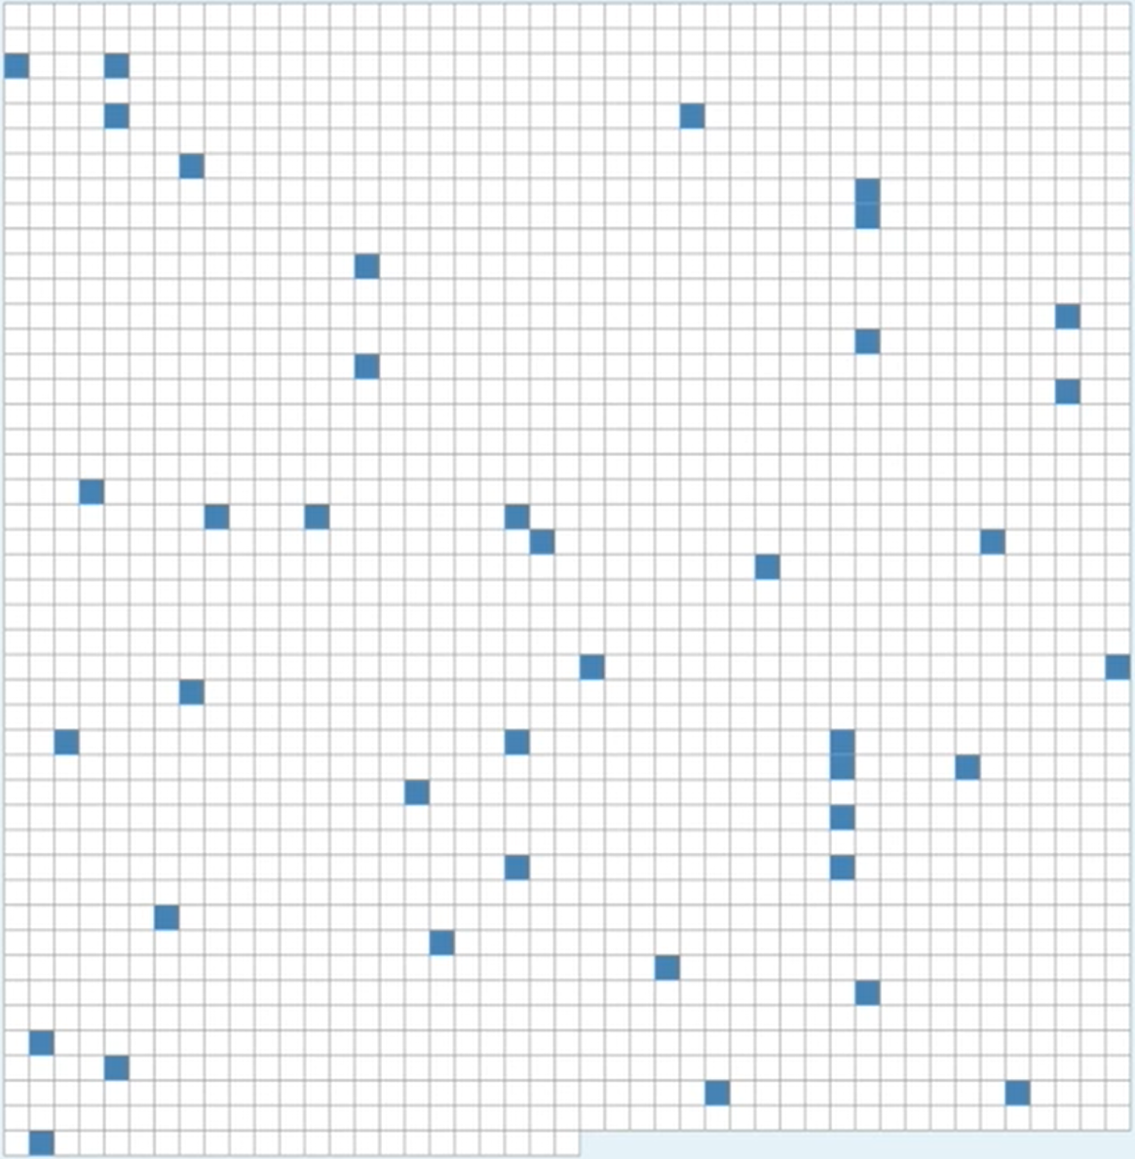
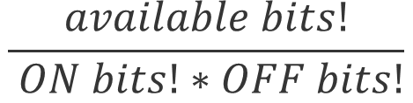
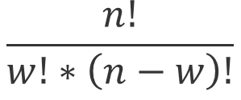
Capacity and Density
n = 16 w = 0 d = 0 c = 1
n = 16 w = 1 d =0.625 c = 16
n = 16 w = 2 d =0.125 c = 120
n = 256 w = 6 d =0.0234 c =368532892176
n = 256 w = 51 d =0.192 c ~ 2034388346E45
n = 2048 w = 40 d =0.0195 c ~ 2371E81
$$\frac{available bits!}{ ON bits!∗OFF bits!}$$
$$\frac{n!}{w!∗\left(n−w\right)!}$$

Slide 31
Using encoder
ScalarEncoder encoder = new ScalarEncoder(new Dictionary<string, object>()
{
{ "W", 21},
{ "N", 1024},
{ "Radius", -1.0},
{ "MinVal", 0.0},
{ "MaxVal", 100.0 },
{ "Periodic", false},
{ "Name", "scalar"},
{ "ClipInput", false},
});
var result = encoder.Encode(i);
int[,] twoDimenArray = ArrayUtils.Make2DArray<int>(result, (int)Math.Sqrt(result.Length), (int)Math.Sqrt(result.Length));
var twoDimArray = ArrayUtils.Transpose(twoDimenArray);
NeoCortexUtils.DrawBitmap(twoDimArray, 1024, 1024, $"{outFolder}\\{i}.png", Color.Yellow, Color.Black, text:i.ToString());

Slide 32
SPATIAL POOLER

Slide 33
What is the Spatial Pooler?
It creates the SDR code of the given input

Slide 34
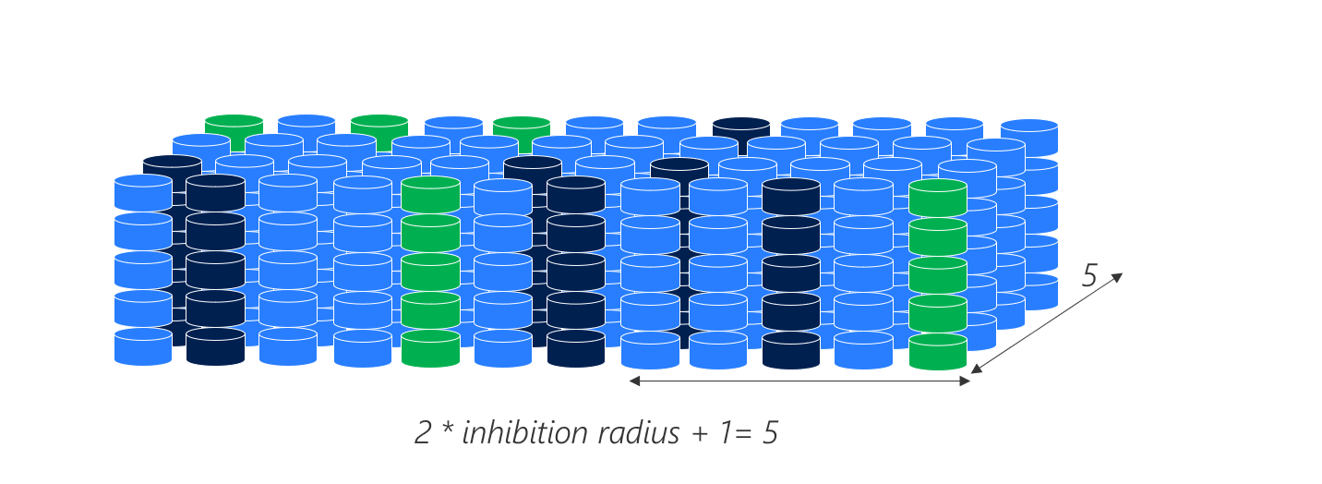
3D representation of the column with mini-columns

Slide 35


MNIST image of digits
SDR code of ‘5’
input
SDR code of ‘3’
input

Slide 36
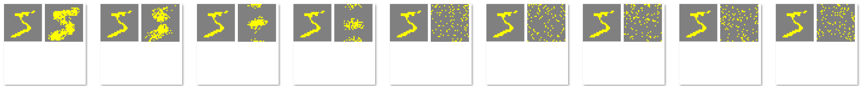
Inhibition Radius
10%
90%

Slide 37
Konfiguration
var htmConfig = new HtmConfig()
{
InputDimensions = new int[] { 5 },
ColumnDimensions = new int[] { 5 },
PotentialRadius = 5,
PotentialPct = 0.5,
GlobalInhibition = false,
LocalAreaDensity = -1.0,
NumActiveColumnsPerInhArea = 3.0,
StimulusThreshold = 0.0,
SynPermInactiveDec = 0.01,
SynPermActiveInc = 0.1,
SynPermConnected = 0.1,
MinPctOverlapDutyCycles = 0.1,
MinPctActiveDutyCycles = 0.1,
DutyCyclePeriod = 10,
MaxBoost = 10,
RandomGenSeed = 42,
Random = new ThreadSafeRandom(42),
};

Slide 38
Using Spatial Pooler
HtmConfig htmConfig = SetupHtmConfigParameters();
mem = new Connections(htmConfig);
sp = new SpatialPoolerMT();
sp.Init(mem);

Slide 39
Using SpatialPooler
public void SpatialSequenceLearningExperiment()
{
var parameters = GetDefaultParams();
parameters.Set(KEY.POTENTIAL_RADIUS, 64 * 64);
parameters.Set(KEY.POTENTIAL_PCT, 1.0);
parameters.Set(KEY.GLOBAL_INHIBITION, false);
parameters.Set(KEY.STIMULUS_THRESHOLD, 0.5);
parameters.Set(KEY.INHIBITION_RADIUS, (int)0.25 * 64 * 64);
parameters.Set(KEY.LOCAL_AREA_DENSITY, -1);
parameters.Set(KEY.NUM_ACTIVE_COLUMNS_PER_INH_AREA, 0.1 * 64 * 64);
parameters.Set(KEY.DUTY_CYCLE_PERIOD, 1000000);
parameters.Set(KEY.MAX_BOOST, 5);
parameters.setInputDimensions(new int[] { 32, 32 });
parameters.setColumnDimensions(new int[] { 64, 64 });
parameters.setNumActiveColumnsPerInhArea(0.02 * 64 * 64);
var sp = new SpatialPooler();
var mem = new Connections();
double[] inputSequence = new double[] { 1.0, 2.0, 3.0, 4.0, 5.0, 6.0, 7.0 };
var inputVectors = GetEncodedSequence(inputSequence, 0.0, 100.0);
parameters.apply(mem);
sp.init(mem);
. . .
}

Slide 40
Using SpatialPooler
public void SpatialSequenceLearningExperiment()
{
. . .
parameters.apply(mem);
sp.init(mem);
foreach (var inputVector in inputVectors)
{
for (int i = 0; i < 3; i++)
{
var activeArray = sp.Compute(inputVector, true) as int[];
var activeCols = ArrayUtils.IndexWhere(activeArray, (el) => el == 1);
var str = Helpers.StringifyVector(activeCols);
Debug.WriteLine(str);
}
}
}

Slide 41
SpatialPooler Compute() nethod
var activeIndicies = sp.Compute(inputVector, true, true) as int[];
var activeArray = sp.Compute(inputVector, true, false) as int[];
Debug.WriteLine(Helpers.StringifyVector(activeArray));
Debug.WriteLine(Helpers.StringifyVector(activeIndicies));
2,3,..
0,0,1,1,0,0..

Slide 42
Examples for Spatial Pooler
All tests are implemented in project: UnitTestsProject
SP Tests:
Experiments: SpatialPoolerResearchTests
UnitTests: SpatialPoolerTests

Slide 43
TEMPORAL MEMORY

Slide 44
Examples for Temporal Memory
All tests are implemented in project: UnitTestsProject
Temporal Memory Tests:
Experiments: NetworkTests.cs
UnitTests: TemporalMemoryTests.cs

Slide 45
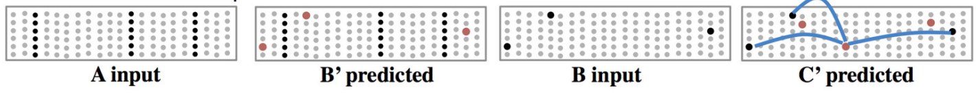
Layers Model & Sequence Memory

Slide 46
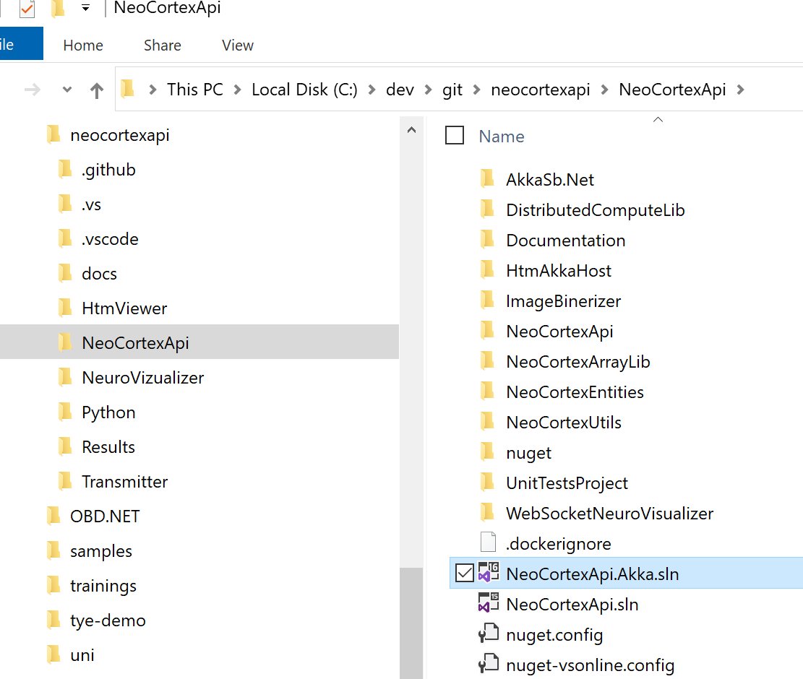
Exercise XII
Working with Spatial Pooler
Tutorial neocortexapi/tutorial.md at master · ddobric/neocortexapi (github.com)
Getting started neocortexapi/gettingStarted.md at master · ddobric/neocortexapi (github.com)
Spatial pooler experiment example neocortexapi/NeoCortexApi/Samples/NeoCortexApiSample at master · ddobric/neocortexapi (github.com)
Working with Temporal Memory
Experiment :neocortexapi/NeoCortexApi/Samples/NeoCortexApiSample at master · ddobric/neocortexapi (github.com)
Analysing SDRs
Tutorial neocortexapi/ColumnActivity.md at master · ddobric/neocortexapi (github.com)
Read references (next slide)

Slide 47
Global Inhibition
5
2 * inhibition radius + 1= 5

Slide 48
Average Span of connected synapses
Min = {1}
Max = {8}
Average = (8-1)/2=3.5
MinX =0, MinY=0
MaxX = 4, MaxY=1
Average((4-0),(1-0))=
(4-1)/2=1.5
1
1
0
0
0
0
0
0
0
1
0
Sensory input
0
0
1
0
0
1
0
0
0
1
0
0
1
0
0
1
0
0
0
1
0
0
4
9

Slide 49

Local Inhibition example
Inhibition Radius = 2, threshold = 0, density=0.5
act = (int)(0.5 + density * neighborhood.Length);
Two higher than 1.0
(0) Winners={}, act=2
1.0
2.0
7.0
0.0
3.0
4.0
16
1.0
1.5
1.7
One higher than 2
(1) Winners={1}, act=2
1.0
2.0
7.0
0.0
3.0
4.0
16
1.0
1.5
1.7
No higher than 7.0
(2) Winners={1,2}, act=3
1.0
2.0
7.0
0.0
3.0
4.0
16
1.0
1.5
1.7
Four higher than 0.0
(3) Winners={1,2}, act=3
1.0
2.0
7.0
0.0
3.0
4.0
16
1.0
1.5
1.7
Three higher than 0.0
(4) Winners={1,2}, act=3
1.0
2.0
7.0
0.0
3.0
4.0
16
1.0
1.5
1.7

Slide 50
Local Inhibition example continue
Inhibition Radius = 2, threshold = 0, density=0.5
act = (int)(0.5 + density * neighborhood.Length);
One with higher than 4.0
(5) Winners={1,2,5}, act=3
1.0
2.0
7.0
0.0
3.0
4.0
16
1.0
1.5
1.7
No higher than 16
(6) Winners={1,2,5,6},act=3
1.0
2.0
7.0
0.0
3.0
4.0
16
1.0
1.5
1.7
Four higher than 1.0
(7) Winners={1,2,5,6},act=3
1.0
2.0
7.0
0.0
3.0
4.0
16
1.0
1.5
1.7
Two higher than 1.5
(8) Winners={1,2,5,6},act=3
1.0
2.0
7.0
0.0
3.0
4.0
16
1.0
1.5
1.7
One higher than 1.7
(9) Winners={1,2,5,6,9},act=3
1.0
2.0
7.0
0.0
3.0
4.0
16
1.0
1.5
1.7

Slide 51
Local Inhibition – Top view on columns

Slide 52
Column Global Inhibition algorithm
Num of columns = 10
Density = 20% => 2 columns can be inhibited.
Chose 2 columns with highest overlap: o(k)
o(0) = 4, o(1) = 0, o(2) = 3 => active columns = {0,2}
c0
c1
c9
0
0
0
0
0
0
0
1
1
1
0
1
1
0
0
0
0
0
1
0

Slide 53
Column Local Inhibition algorithm
Num of columns = 10
Inhibition radius = 2. Means 5 columns can be reached.
Density = 50% =>50% of 5 reached columns can be inhibited =>2-5
Now calculate N: num of cols with bigger overlap then focusing col.
Focus col=0, span 0,1,2=3, 50% of (3)+0.5 = (int)2, N=2 {1,2}/[2,7] (-)
Focus col=1, span 0,1,2,3=4, 50% of (3)+0.5 = (int)2, N=1 {1}/[7]<2 (+)
Focus col=2,span 0,1,2,4=4, 50% of (2)+0.5 = (int)3, N=0 {2,7}<2 (+)
1 2 7 0 3 4 16 1 1.5 1.7

Slide 54
MATH C#
---------------------------------------------------------------
x1 = {1.2, 2.8, 3.5} | var x1 = new double[] {1.2, 2.8, 3.5}
x2 = {1.2, 2.5, 2.9} | var x1 = new double[] {1.2, 2.5, 2.9}
xN
----------------------------------------------------------------
double[][] inputVectors = new double[N][];
inputVectors[0] = x1;
inputVectors[1] = x2;
...
inputVectors[N] = xN;
--- Another way ------------
List<double[]> inputVectors = List<double[]>();
inputVectors.Add(x1);
inputVectors.Add(x2);
..
inputVectors.Add(xN);

Slide 55
References
https://www.youtube.com/watch?v=Ub1fE-bAroA
https://en.wikipedia.org/wiki/Hierarchical_temporal_memory
https://www.youtube.com/watch?v=nBYddmFg4nQ
https://web.archive.org/web/20110714212402/http://www.numenta.com/htm-overview/education.php
Spatial Pooling Algorithm Details (numenta.com)

Slide 56

Thank You

